Slide 1
Graphs (Graph Algorithms)

Slide 2
Topological Ordering
3
1
4
0
2
5

Slide 3
Topological Ordering
3
1
4
0
2
5
TOPOLOGICAL ORDER: 5 – 4 – 2 – 3 – 1 – 0

Slide 4
Graphs (Graph Algorithms)

Slide 5
Graphs
„Graph theory is the study of graphs, which are mathematical structures
used to model pairwise relations between objects”
→ given G(V,E) graphs are made up of V nodes (vertices) that are connected by E edges (links)
C
A
D
B

Slide 6
Graphs
There are two main types of graphs: directed graphs and undirected graphs
1.) UNDIRECTED GRAPHS: an undirected graph G(V,E) is a set of vertices
and edges where the edges are bidirectional. It means that
edge (u,v) is identical to the edge (v,u)
C
A
D
B
Note: the edges may have weights as well!

Slide 7
Graphs
There are two main types of graphs: directed graphs and undirected graphs
2.) DIRECTED GRAPHS: a directed graph G(V,E) is a set of vertices
and edges where the edges have direction. It means that
edge (u,v) is identical to the edge (v,u)
C
A
D
B
Note: the edges may have weights as well!

Slide 8
Graphs
There are several important graph types we have to consider:
1.) TREES: tree is an undirected graph where any
two vertices (nodes) are connected by
exactly one path
C
A
D
B

Slide 9
Graphs
There are several important graph types we have to consider:
2.) FORESTS: forest is an undirected graph, all of
whose connected components are trees
(disjoint union of trees)
C
A
H
E
D
I
B
G
F

Slide 10
Graphs
There are several important graph types we have to consider:
3.) DIRECTED ACYCLIC GRAPH (DAG): it is a
finite directed graph with no directed cycles
(crucial in many algorithms)
C
A
D
B
E
F

Slide 11
Graphs
There are several important graph types we have to consider:
4.) COMPLETE GRAPH: in complete graphs, every
single pair of vertices (nodes) are connected
C
A
H
E
D
G
I
B
F

Slide 12
Graph Representations (Graph Algorithms)

Slide 13
Graphs
How to represent these G(V,E) graphs in a programming language?
1.) ADJACENCY LIST REPRESENTATION
We assign a data structure (array) to every
single vertex (node) in the graph that
stores the edges accordingly
4
C
A
2
D
B
3

Slide 14
Graphs
How to represent these G(V,E) graphs in a programming language?
1.) ADJACENCY LIST REPRESENTATION
We assign a data structure (array) to every
single vertex (node) in the graph that
stores the edges accordingly
4
C
A
A : [(4,C),(2,B)]
B : [(3,D)]
C : []
D : []
2
D
B
3

Slide 15
Graphs
How to represent these G(V,E) graphs in a programming language?
1.) ADJACENCY LIST REPRESENTATION
Space efficient when dealing with sparse
graphs but inefficient with dense ones
4
C
A
2
D
B
3

Slide 16
Graphs
How to represent these G(V,E) graphs in a programming language?
1.) ADJACENCY LIST REPRESENTATION
Space efficient when dealing with sparse
graphs but inefficient with dense ones
4
C
A
iterating over all the edges is efficient
2
D
B
3
edge weight lookup is slow O(E) because we have to find it in linear time

Slide 17
Graphs
How to represent these G(V,E) graphs in a programming language?
2.) ADJACENCY MATRIX REPRESENTATION
Let’s assume we have a G(V,E) graph with
V vertices (nodes) and E edges (links)
We can construct an M matrix with size VxV
where M[i][j] represents the edge weight
of going from node i to node j
4
C
A
2
D
B
3

Slide 18
Graphs
How to represent these G(V,E) graphs in a programming language?
2.) ADJACENCY MATRIX REPRESENTATION
We can construct an M matrix with size VxV
where M[i][j] represents the edge weight
of going from node i to node j
4
C
A
A B C D
2
D
A
B
C
D
0 2 4 0
0 0 0 3
B
3
0 0 0 0
0 0 0 0

Slide 19
Graphs
How to represent these G(V,E) graphs in a programming language?
2.) ADJACENCY MATRIX REPRESENTATION
We can construct an M matrix with size VxV
where M[i][j] represents the edge weight
of going from node i to node j
C
A
A B C D
D
A
B
C
D
0 0 1 0
B
0 0 1 1
1 1 0 0
Note: undirected graphs have symmetric
adjacency matrix representations!
0 1 0 0

Slide 20
Graphs
How to represent these G(V,E) graphs in a programming language?
2.) ADJACENCY MATRIX REPRESENTATION
Space efficient with dense graphs but it
requires O(V²) memory
4
C
A
edge weight lookup is O(1)
2
D
B
3
iterating over all edges takes O(E²)

Slide 21
Applications of Graphs (Graph Algorithms)

Slide 22
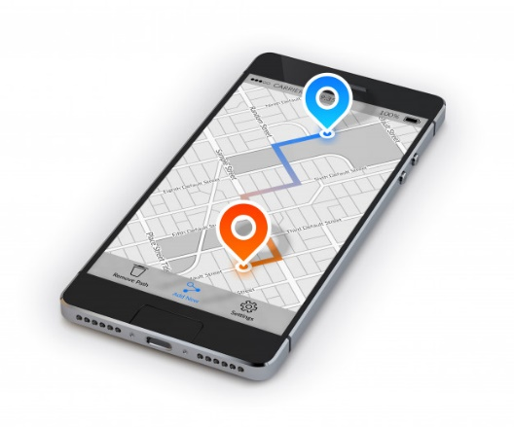
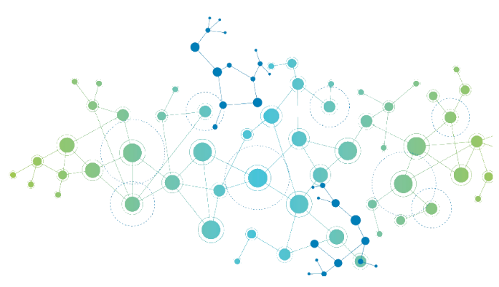
Applications of Graphs
1.) SHORTEST PATH ALGORITHMS are used on a daily basis (Google Maps, Waze etc.)
→ Dijkstra’s shortest path algorithm can find the shortest path
between two or more locations quite fast
arbitrage opportunities on the FOREX can be detected with the help
of Bellman-Ford algorithm (detecting negative cycles)
shortest path algorithms are used in photo editing softwares
as well (Photoshop, Gimp)
computer networks: Open Shortest Path First (OSPF) is a routing
protocol for computer networks that helps to navigate
packages on the web

Slide 23
Applications of Graphs
2.) GOOGLE’S PAGE RANK ALGORITHM
Graph traversal algorithms (especially breath-first search) can
traverse huge networks such as the WWW
→ this is how Google’s Spider crawls the web and keeps
indexing the web pages (page rank calculation)

Slide 24
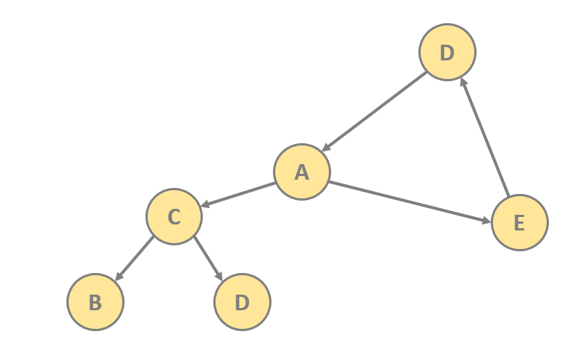
Applications of Graphs
3.) SOFTWARE ENGINEERING
Let’s consider software project management tools such as Maven or Gradle.
The problem is that packages or modules (dependencies) may depend on
each other: the order of compilation is important
→ this problem can be reduced to the problem
of cycles in a graph and directed acyclic graphs (DAGs)

Slide 25
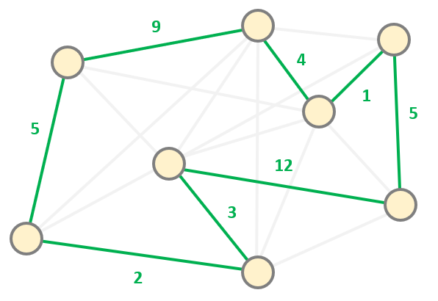
Applications of Graphs
4.) OPTIMIZATION PROBLEMS
Most of the quadratic optimization related problems can be transformed
into a graph theory related problem
→ maximum flow problem (max flow min cut problem)
→ circulation problem and airline scheduling
→ vehicle routing problem etc.

Slide 26
Topological Ordering (Graph Algorithms)

Slide 27
Topological Ordering
the depth-first search based algorithm was first constructed by Robert Tarjan back in 1976
topological ordering (topological sort) of a G(V,E) directed graph is a linear ordering of its vertices such that for every directed (u,v) edge u comes before v in the ordering
the V vertices of the G(V,E) graph may represent tasks to be performed and the edges are the constraints (one task may be permormed before another)
TOPOLOGICAL ORDERING (SORTING) YIELDS THE VALID SEQUENCE FOR THE TASKS

Slide 28
Topological Ordering
this is a directed
acyclic graph (DAG)
which means there
are no cycles in the
G(V,E) graph
A
we can use topological ordering if only the G(V,E) graph does not have any cycles
so it is a directed acyclic graph (DAG)
any directed acyclic graph has at least one topological order
C
B
D
E

Slide 29
Topological Ordering
A
there is a cycle in the
G(V,E) graph so we can
not use topological ordering
we can use topological ordering if only the G(V,E) graph does not have any cycles
so it is a directed acyclic graph (DAG)
any directed acyclic graph has at least one topological order
C
B
D
E

Slide 30
Topological Ordering
topological ordering (topological sort) has O(V+E) linear running time complexity
it is crucial in project management and in finding Hamiltonian paths and cycles
Hamiltonian path in a G(V,E) graph visits every vertex exactly once
if a Hamiltonian path exits then the topological sort order is unique
if a topological sort does not form a Hamiltonian path it means the DAG has more valid topological orderings
it is NP-complete problem to find the Hamiltonian path but we can decide whether such path exists in O(V+E) runing time with topological sort

Slide 31
Topological Ordering
basically we have to
find V vertices with no
incoming edges
in the G(V,E) graph
in every iteration
D
A
C
B
E

Slide 32
Topological Ordering
basically we have to
find V vertices with no
incoming edges
in the G(V,E) graph
in every iteration
D
A
C
B
E

Slide 33
Topological Ordering
basically we have to
find V vertices with no
incoming edges
in the G(V,E) graph
in every iteration
D
A
C
B
E
TOPOLOGICAL ORDER: A

Slide 34
Topological Ordering
basically we have to
find V vertices with no
incoming edges
in the G(V,E) graph
in every iteration
D
A
C
B
E
TOPOLOGICAL ORDER: A – B

Slide 35
Topological Ordering
basically we have to
find V vertices with no
incoming edges
in the G(V,E) graph
in every iteration
D
A
C
B
E
TOPOLOGICAL ORDER: A – B

Slide 36
Topological Ordering
basically we have to
find V vertices with no
incoming edges
in the G(V,E) graph
in every iteration
D
A
C
B
E
TOPOLOGICAL ORDER: A – B – E

Slide 37
Topological Ordering
basically we have to
find V vertices with no
incoming edges
in the G(V,E) graph
in every iteration
D
A
C
B
E
TOPOLOGICAL ORDER: A – B – E

Slide 38
Topological Ordering
basically we have to
find V vertices with no
incoming edges
in the G(V,E) graph
in every iteration
D
A
C
B
E
TOPOLOGICAL ORDER: A – B – E – C

Slide 39
Topological Ordering
basically we have to
find V vertices with no
incoming edges
in the G(V,E) graph
in every iteration
D
A
C
B
E
TOPOLOGICAL ORDER: A – B – E – C

Slide 40
Topological Ordering
basically we have to
find V vertices with no
incoming edges
in the G(V,E) graph
in every iteration
D
A
C
B
E
TOPOLOGICAL ORDER: A – B – E – C – D

Slide 41
Topological Ordering
basically we have to
find V vertices with no
incoming edges
in the G(V,E) graph
in every iteration
D
A
C
B
E
TOPOLOGICAL ORDER: A – B – E – C – D

Slide 42
Topological Ordering
there are several applications of topological ordering
it is crucial in project management softwares to decide the order in which the tasks should be executed
when we have a large application with several dependencies
this is why Ant, Maven and Gradle came to be

Slide 43
Topological Ordering
FOURIER SERIES
LINEAR ALGEBRA
CALCULUS
DIFFERENTIAL
EQUATIONS
STOCHASTIC PROCESSES

Slide 44
Topological Ordering
FOURIER SERIES
LINEAR ALGEBRA
CALCULUS
DIFFERENTIAL
EQUATIONS
STOCHASTIC PROCESSES

Slide 45
Topological Ordering
FOURIER SERIES
LINEAR ALGEBRA
CALCULUS
DIFFERENTIAL
EQUATIONS
STOCHASTIC PROCESSES

Slide 46
Topological Ordering
FOURIER SERIES
LINEAR ALGEBRA
CALCULUS
DIFFERENTIAL
EQUATIONS
STOCHASTIC PROCESSES

Slide 47
Topological Ordering
FOURIER SERIES
LINEAR ALGEBRA
CALCULUS
DIFFERENTIAL
EQUATIONS
STOCHASTIC PROCESSES

Slide 48
Topological Ordering
FOURIER SERIES
LINEAR ALGEBRA
CALCULUS
DIFFERENTIAL
EQUATIONS
STOCHASTIC PROCESSES

Slide 49
Topological Ordering
FOURIER SERIES
LINEAR ALGEBRA
CALCULUS
DIFFERENTIAL
EQUATIONS
STOCHASTIC PROCESSES

Slide 50
Topological Ordering
FOURIER SERIES
LINEAR ALGEBRA
CALCULUS
DIFFERENTIAL
EQUATIONS
STOCHASTIC PROCESSES

Slide 51
Topological Ordering
FOURIER SERIES
LINEAR ALGEBRA
CALCULUS
DIFFERENTIAL
EQUATIONS
STOCHASTIC PROCESSES

Slide 52
DAG Shortest Path (Graph Algorithms)

Slide 53
DAG Shortest Path
usually we use Dijkstra’s algorithm if we want to find the shortest path in an arbitrary G(V,E) graph
can we do better if the G(V,E) graph is a directed acyclic graph?
WE CAN ACHIEVE LINEAR RUNNING TIME TO CALCULATE THE SHORTEST PATH IN A G(V,E) DIRECTED ACYCLIC GRAPH
we can find the shortest path in a directed acyclic graph (DAG) with topological ordering in O(V+E) linear running time
it only works when there a valid topological order exists

Slide 54
DAG Shortest Path
do the topological ordering on the G(V,E) graph
for each u vertex in the topological order
for each edge (u,v) with weight w
if distance[u] + w < distance[v]
distance[v] = distance[u] + w

Slide 55
DAG Shortest Path
do the topological ordering on the G(V,E) graph
for each u vertex in the topological order
for each edge (u,v) with weight w
if distance[u] + w < distance[v]
distance[v] = distance[u] + w
this is the relaxation process when
we check whether a shorter path exists to
vertex v including vertex u

Slide 56
DAG Shortest Path
v
s
if we find a shorter path
to the v vertex via u vertex
RELAXATION PROCESS
we have to check if
distance[v] < distance[u] + w
which means we have
found a shorter path
this is the source vertex
which is the starting point
(we calculate the shortest path
to every other vertex starting
with the s vertex)
w
u

Slide 57
Topological Ordering
6
A
B
2
1
S
E
4
1
2
1
C
D
3

Slide 58
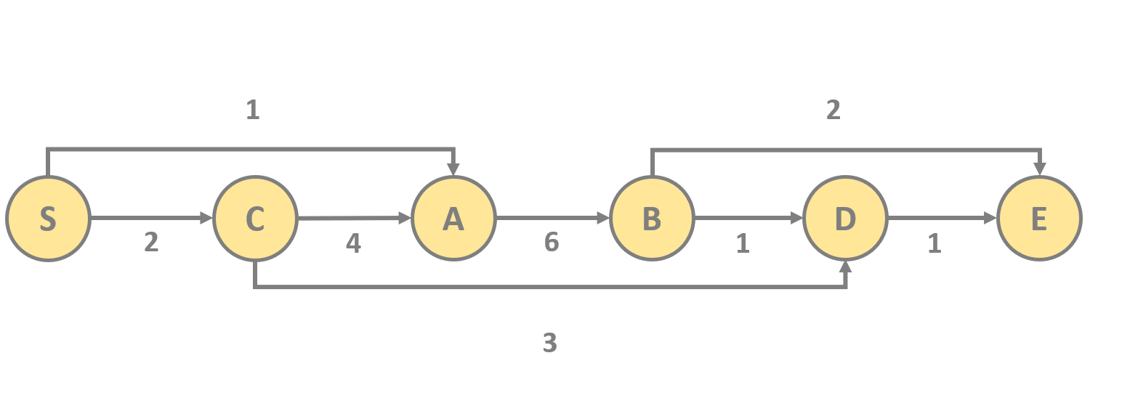
Topological Ordering
1
2
S
C
A
B
D
E
2
4
6
1
1
3

Slide 59
Dynamic Programming (Graph Algorithms)

Slide 60
Dynamic Programming Paradigm
dynamic programming is both an optimization technique and a computer programming method
it was introduced by Richard Bellman in 1953
the main idea is that we can break down complicated problems into smaller subproblems in a recursive manner
then we find the solutions for these subproblems and finally we combine the subresults to find the final solution

Slide 61
Dynamic Programming Paradigm
dynamic programming is a method for solving a complex problem by breaking it down into a collection of simpler subproblems
it is applicable to problems exhibiting the properties of overlapping subproblems
dynamic programming takes far less time than other methods that don't take advantage of the subproblem overlap
we need to solve different parts of the problem (subproblems) + combine the solutions of the subproblems to reach an overall solution
we solve each subproblems only once - we reduce the number of computations
subproblems can be stored in memory - memoization and tabulation

Slide 62
Dynamic Programming Paradigm
OPTIMAL SUBSTRUCTURE
In computer science, a problem is said to have optimal substructure if an optimal solution can be constructed from optimal solutions of its subproblems
BELLMAN-EQUATION
Of course there is a relationship between the subresults and the final result – this is what the Bellman-equation defines

Slide 63
Dynamic Programming Paradigm
„If a given problem has optimal substructure and overlapping subproblems
then we can use dynamic programming appraoch”

Slide 64
Dynamic Programming Paradigm
F(N)
F(N) = F(N-1) + F(N-2)
F(N-1)
F(N-2)
the formula for calculating the N-th
Fibonacci-number with recursion
(note that there are several overlapping
subproblems we have to solve several times)
dynamic programming use
memoization or tabulation
to store these values
(so there is no need for recalculating them)
F(N-2)
F(N-3)
F(N-3)
F(N-4)

Slide 65
Dynamic Programming with DAGs
there is a relationship between dynamic programming approaches and directed acyclic graphs (DAGs)
most of the dynamic programming related problems can be transformed into a G(V,E) graph
this G(V,E) graph is a directed acyclic graph (DAG)
we just have to do a shortest path (or longest path) algorithm on the graph to find the solution for the original problem

Slide 66
Longest Increasing Subsequence Problem
we have an A array of integers [6,2,8,4,5,7] and we want to find the longest increasing subsequence – in this case [2,4,5,7]
we can solve this problem with recursion and with dynamic programming as well
WE CAN CREATE A DIRECTED ACYCLIC GRAPH (DAG) OUT OF THESE VALUES
we create N nodes where N is the number of items in the array
there is a directed edghe from node i to node j if A[i] < A[j]

Slide 67
Longest Increasing Subsequence Problem
6
2
4
5
8
7
4
5
7
5
7
7
5
7
7
7

Slide 68
Longest Increasing Subsequence Problem
6
2
4
5
8
7
4
5
7
5
7
7
5
7
7
7

Slide 69
Cycle Detection (Graph Algorithms)

Slide 70
Cycle Detection
the aim is to find cycles in a directed G(V,E) graph
sometimes we want to find cylces – when we try to detect arbitrage opportunities on the FOREX
arbitrage trading involves the buying and selling of different currency pairs to exploit any pricing inefficiencies

Slide 71
Cycle Detection
GBP
USD
CHF
EUR
CAD

Slide 72
Cycle Detection
the aim is to find cycles in a directed G(V,E) graph
usually we represent a set of dependencies with directed graphs
USUALLY CYCLES MEAN DEADLOCK !!!
deadlock is a common case in multithreaded environment
each thread try to acquire a lock to a resource that is already locked by another thread

Slide 73
Operating Systems and Cycles
it is absolutely crucial in operating systems to avoid cycles or cyclic dependecies in the main
the underlying operating system creates a new process for every single active program that can be managed independently
IT IS CURCIAL TO AVOID CYCLES AND DEADLOCKS
this is why the resource allocation graph (RAG) is constructed
we have to make sure we can not find a any cycles in this G(V,E) allocation graph

Slide 74
Cycle Detection
D
A
C
E
B
D

Slide 75
Cycle Detection
D
A
C
E
B
D

Slide 76
Cycle Detection
D
A
C
E
B
D

Slide 77
Cycle Detection
D
A
C
E
B
D

Slide 78
Cycle Detection
D
A
C
E
B
D

Slide 79
Cycle Detection
D
A
C
E
B
D

Slide 80
Cycle Detection
D
A
C
E
B
D

Slide 81
Cycle Detection
D
A
C
E
B
D

Slide 82
Cycle Detection
D
A
C
E
B
D

Slide 83
Cycle Detection
D
A
C
E
B
D

Slide 84
Cycle Detection
D
A
C
E
B
D

Slide 85
Cycle Detection
D
A
C
E
B
D

Slide 86
Cycle Detection
D
A
C
E
B
D

Slide 87
Cycle Detection
when we consider a
u vertex in the G(V,E) graph
that is being visited
THIS IS WHEN WE
DETECT A CYCLE !!!
it has something to do
with bakcward edges
int the G(V,E) graph
D
A
C
E
B
D

Slide 88
Backward and Forward Edges
depth-first search always
yields a depth-first search tree which is
the order in which we visit the vertices
FORWARD EDGE
a forward (u,v) edge points from
a node u to one of its v descendants
BACKWARD EDGE
a backward (u,v) edge points from
a node u to one of its v ancestors
BACKWARD EDGES
ALWAYS INDICATES CYCLES
D
A
C
E
B
D

Slide 89
Backward and Forward Edges
depth-first search always
yields a depth-first search tree which is
the order in which we visit the vertices
FORWARD EDGE
a forward (u,v) edge points from
a node u to one of its v descendants
BACKWARD EDGE
a backward (u,v) edge points from
a node u to one of its v ancestors
BACKWARD EDGES
ALWAYS INDICATES CYCLES
D
forward
edge
A
C
E
B
D

Slide 90
Backward and Forward Edges
depth-first search always
yields a depth-first search tree which is
the order in which we visit the vertices
FORWARD EDGE
a forward (u,v) edge points from
a node u to one of its v descendants
BACKWARD EDGE
a backward (u,v) edge points from
a node u to one of its v ancestors
BACKWARD EDGES
ALWAYS INDICATES CYCLES
D
backward
edge
A
C
E
B
D

Slide 91
Strongly Connected Components (Graph Algorithms)

Slide 92
Strongly Connected Components
a G(V,E) graph is connected if all its vertices are connected
a graph is strongly connected if we can get from any vertex to any other vertex
undirected graphs are strongly connected by definition
in directed graphs there may be vertices that can not be reached from everywhere
these clusters can be discovered with DFS
we can find the strongly connected components of a graph in O(V) time
if we shrink each component to a vertex these vertices form a DAG
this is the condensation of the given graph
so a directed graph is a DAG only if there is no subgraph that is strongly connected

Slide 93
Strongly Connected Components
1
2
3
4
5
6
7
8

Slide 94
Strongly Connected Components
1
2
3
4
5
6
7
8

Slide 95
Strongly Connected Components
348
we can shrink each component
to a single vertex (condensation)
THIS GRAPH WILL BE A DIRECTED ACYCLIC GRAPH (DAG)
there are no cycles in
this condensed G’(V,E) graph
125
67

Slide 96
Strongly Connected Components
a directed cycle is strongly connected
every non-trivial strongly connected component contains at least one directed cycle
there are 2 popular algorithms for finding the strongly connected components in a G(V,E) graph
1.) KOSARAJU ALGORITHM
2.) TARJAN ALGORITHM

Slide 97
Strongly Connected Components
KOSARAJU ALGORITHM
doest two DFSs one to get the
topological ordering and
then on the G’(V,E) transposed
graph to discover the
strongly connected components
transpose of a G(V,E) graph is
when we reverse each edges so
change the start and
end vertices accordingly
TARJAN ALGORITHM
it uses only one DFS so it is much
more popular in practise
a bit more complicated to
understand and to implement
both of the approaches has
O(V+E) linear running time

Slide 98
Strongly Connected Components Applications (Graph Algorithms)

Slide 99
Strongly Connected Components
- ECOLOGY -
we can determine the hierarchy of food chains and
the strongly connected clusters are depending on each other

Slide 100
Strongly Connected Components
- ECOLOGY -
we can determine the hierarchy of food chains and
the strongly connected clusters are depending on each other
- SOFTWARE ENGINEERING -
if we have a huge software and want to create packages to each connected classes we can classify according to the strongly connected components

Slide 101
Strongly Connected Components
- ECOLOGY -
we can determine the hierarchy of food chains and
the strongly connected clusters are depending on each other
- SOFTWARE ENGINEERING -
if we have a huge software and want to create packages to each connected classes we can classify according to the strongly connected components
- RECOMMENDER SYSTEMS -
we can recommend another item from the same strongly connected component or cluster (YouTube or Facebook)

Slide 102
Kosaraju’s Algorithm (Graph Algorithms)

Slide 103
Kosaraju’s Algorithm
we have to use a stack for depth-first traversal because we have to track the finishing times
this is a standard topological ordering
we need to track whether we have already visited a given node or not

Slide 104
Kosaraju’s Algorithm
do a depth-first search (topological ordering) on the
original G(V,E) graph

Slide 105
Kosaraju’s Algorithm
do a depth-first search (topological ordering) on the
original G(V,E) graph
transpose the original G(V,E) graph to get
the transposed G’(V,E) graph

Slide 106
Kosaraju’s Algorithm
do a depth-first search (topological ordering) on the
original G(V,E) graph
transpose the original G(V,E) graph to get
the transposed G’(V,E) graph
consider all the vertices in the topological order
and construct the strongly connected components

Slide 107
Kosaraju’s Algorithm
A
C
A
C
F
E
F
E
we have to do a standard
topological ordering on the
original G(V,E) graph
we use the G’(V,E) transposed
graph to Find the strongly
connected components

Slide 108
Kosaraju’s Algorithm
1
2
3
4
5
6
7
8
STACK

Slide 109
Kosaraju’s Algorithm
1
2
3
4
5
6
7
8
STACK

Slide 110
Kosaraju’s Algorithm
1
2
3
4
5
6
7
8
STACK

Slide 111
Kosaraju’s Algorithm
1
2
3
4
5
6
7
8
STACK

Slide 112
Kosaraju’s Algorithm
1
2
3
4
5
6
7
8
STACK

Slide 113
Kosaraju’s Algorithm
1
2
3
4
5
6
7
8
STACK

Slide 114
Kosaraju’s Algorithm
1
2
3
4
5
6
7
8
STACK

Slide 115
Kosaraju’s Algorithm
1
2
3
4
5
6
7
8
STACK

Slide 116
Kosaraju’s Algorithm
1
2
3
4
5
6
7
8
6
STACK

Slide 117
Kosaraju’s Algorithm
1
2
3
4
5
6
7
8
7
6
STACK

Slide 118
Kosaraju’s Algorithm
1
2
3
4
5
6
7
8
8
7
6
STACK

Slide 119
Kosaraju’s Algorithm
1
2
3
4
4
5
6
7
8
8
7
6
STACK

Slide 120
Kosaraju’s Algorithm
1
2
3
4
3
4
5
6
7
8
8
7
6
STACK

Slide 121
Kosaraju’s Algorithm
1
2
3
4
3
4
5
6
7
8
8
7
6
STACK

Slide 122
Kosaraju’s Algorithm
1
2
3
4
5
3
4
5
6
7
8
8
7
6
STACK

Slide 123
Kosaraju’s Algorithm
1
2
3
4
2
5
3
4
5
6
7
8
8
7
6
STACK

Slide 124
Kosaraju’s Algorithm
1
1
2
3
4
2
5
3
4
5
6
7
8
8
7
6
STACK

Slide 125
Kosaraju’s Algorithm
1
1
2
3
4
2
5
3
4
5
6
7
8
8
7
6
STACK

Slide 126
Kosaraju’s Algorithm
1
1
2
3
4
2
5
3
4
5
6
7
8
8
7
6
STACK

Slide 127
Kosaraju’s Algorithm
1
2
3
4
2
5
3
4
5
6
7
8
8
7
6
STACK

Slide 128
Kosaraju’s Algorithm
1
2
3
4
2
5
3
4
5
6
7
8
8
7
6
STACK

Slide 129
Kosaraju’s Algorithm
1
2
3
4
2
5
3
4
5
6
7
8
8
7
6
STACK

Slide 130
Kosaraju’s Algorithm
1
2
3
4
2
5
3
4
5
6
7
8
8
7
6
STACK

Slide 131
Kosaraju’s Algorithm
1
2
3
4
2
5
3
4
5
6
7
8
8
7
6
STACK

Slide 132
Kosaraju’s Algorithm
1
2
3
4
5
3
4
5
6
7
8
8
7
6
STACK

Slide 133
Kosaraju’s Algorithm
1
2
3
4
5
3
4
5
6
7
8
8
7
6
STACK

Slide 134
Kosaraju’s Algorithm
1
2
3
4
3
4
5
6
7
8
8
7
6
STACK

Slide 135
Kosaraju’s Algorithm
1
2
3
4
3
4
5
6
7
8
8
7
6
STACK

Slide 136
Kosaraju’s Algorithm
1
2
3
4
4
5
6
7
8
8
7
6
STACK

Slide 137
Kosaraju’s Algorithm
1
2
3
4
4
5
6
7
8
8
7
6
STACK

Slide 138
Kosaraju’s Algorithm
1
2
3
4
4
5
6
7
8
8
7
6
STACK

Slide 139
Kosaraju’s Algorithm
1
2
3
4
4
5
6
7
8
8
7
6
STACK

Slide 140
Kosaraju’s Algorithm
1
2
3
4
4
5
6
7
8
8
7
6
STACK

Slide 141
Kosaraju’s Algorithm
1
2
3
4
5
6
7
8
8
7
6
STACK

Slide 142
Kosaraju’s Algorithm
1
2
3
4
5
6
7
8
8
7
6
STACK

Slide 143
Kosaraju’s Algorithm
1
2
3
4
5
6
7
8
7
6
STACK

Slide 144
Kosaraju’s Algorithm
1
2
3
4
5
6
7
8
7
6
STACK

Slide 145
Kosaraju’s Algorithm
1
2
3
4
5
6
7
8
6
STACK

Slide 146
Kosaraju’s Algorithm
1
2
3
4
5
6
7
8
6
STACK

Slide 147
Kosaraju’s Algorithm
1
2
3
4
5
6
7
8
6
STACK

Slide 148
Kosaraju’s Algorithm
1
2
3
4
5
6
7
8
6
STACK

Slide 149
Kosaraju’s Algorithm
1
2
3
4
5
6
7
8
STACK

Slide 150
Tarjan’s Algorithm (Graph Algorithms)

Slide 151
Tarjan’s Algorithm
it is able to find the strongly connected components in a directed G(V,E) graph with a single depth-first search
the algorithm was first constructed by Robert Tarjan back in 1972
it has a linear O(V+E) running time complexity

Slide 152
Tarjan’s Algorithm
Every node of the G(V,E) graph has two properties – an index and a lowlink parameter
we assign an integer index to the nodes consecutively in the order they are visited by depth-first search

Slide 153
Tarjan’s Algorithm
Every node of the G(V,E) graph has two properties – an index and a lowlink parameter
we assign an integer index to the nodes consecutively in the order they are visited by depth-first search
every node has another lowlink integer value that is the smallest index of any node known to be reachable from node v

Slide 154
Tarjan’s Algorithm
Every node of the G(V,E) graph has two properties – an index and a lowlink parameter
1.) v.lowlink = v.index
There is no backward edge to any other node so the current
node is the root node of a strongly connected component
2.) v.lowlink < v.index
In this case we know that there is a backward edge

Slide 155
Tarjan’s Algorithm
A
E
C
G
D

Slide 156
Tarjan’s Algorithm
0
A
E
C
G
D

Slide 157
Tarjan’s Algorithm
0
A
E
1
C
G
D

Slide 158
Tarjan’s Algorithm
0
2
A
E
1
C
G
D

Slide 159
Tarjan’s Algorithm
0
2
A
E
1
3
C
G
D

Slide 160
Tarjan’s Algorithm
0
2
A
E
1
3
4
C
G
D

Slide 161
Tarjan’s Algorithm
the integer lowlink value
is the smallest index
of any node known to be
reachable from
the actual node v
(including itself)
NODES WITH THE SAME LOWLINK VALUE
BELONG TO THE
SAME COMPONENT
0
2
A
E
1
3
4
C
G
D

Slide 162
Tarjan’s Algorithm
the integer lowlink value
is the smallest index
of any node known to be
reachable from
the actual node v
(including itself)
NODES WITH THE SAME LOWLINK VALUE
BELONG TO THE
SAME COMPONENT
(0,0)
(2,0)
A
E
(1,0)
(3,3)
(4,3)
C
G
D

Slide 163
Tarjan’s Algorithm
the integer lowlink value
is the smallest index
of any node known to be
reachable from
the actual node v
(including itself)
NODES WITH THE SAME LOWLINK VALUE
BELONG TO THE
SAME COMPONENT
(0,0)
(2,0)
A
E
(1,0)
(3,3)
(4,3)
C
G
D

Slide 164
Tarjan’s Algorithm
PROBLEM IS THAT LOWLINK VALUES ARE DEPENDING
ON THE ORDER OF THE DEPTH-FIRST SEARCH
this is why the stack invariant principle is crucial
in Tarjan’s algorithm
this principle makes sure the lowlink values
are going to be consistent
(we will use a stack in which we store the nodes
from which to update lowlink values – the node must be on the stack
to be able to update the lowlink value)

Slide 165
Stack Invariant
When depth-first search recursively visits a node v and its descendants
→ those nodes are not necessarily popped from the stack when the recursive call returns
→ a node remains on the stack after it has been visited if there exists a path in the graph from this node to some node earlier on the stack

Slide 166
Stack Invariant
G
D
A
E
B
F

Slide 167
Stack Invariant
G
D
A
E
B
F

Slide 168
Stack Invariant
G
D
A
E
B
F

Slide 169
Stack Invariant
G
D
A
E
B
F

Slide 170
Stack Invariant
G
D
A
E
B
F

Slide 171
Stack Invariant
G
D
A
E
B
F

Slide 172
Stack Invariant
G
D
A
E
B
F

Slide 173
Stack Invariant
G
D
A
E
B
F

Slide 174
Stack Invariant
G
D
A
E
B
F

Slide 175
Stack Invariant
G
D
A
E
B
F

Slide 176
Stack Invariant
G
D
A
E
B
F

Slide 177
Stack Invariant
G
D
A
E
B
F

Slide 178
Stack Invariant
So at the end of therecursively call that visits vertex v – we know whether
vertex v itself has a path to any node earlier (ancestor nodes) on the stack
YES
vertex v has a path to any node earlier on the stack
so the recursive call returns and v stays on the stack

Slide 179
Stack Invariant
So at the end of therecursively call that visits vertex v – we know whether
vertex v itself has a path to any node earlier (ancestor nodes) on the stack
YES
vertex v has a path to any node earlier on the stack
so the recursive call returns and v stays on the stack
NO
vertex v does not have a path to any node earlier on the stack
so node v must be the root of its strongly connected component

Slide 180
Tarjan’s Algorithm
1
2
3
4
5
6
7
8
STACK

Slide 181
Tarjan’s Algorithm
1
2
3
4
5
6
7
8
6
STACK

Slide 182
Tarjan’s Algorithm
1
2
3
4
5
6
7
8
(0,0)
6
STACK

Slide 183
Tarjan’s Algorithm
1
2
3
4
5
6
7
8
7
(0,0)
6
STACK

Slide 184
Tarjan’s Algorithm
1
2
3
4
5
6
7
8
7
(0,0)
(1,1)
6
STACK

Slide 185
Tarjan’s Algorithm
1
2
3
4
5
6
7
8
7
(0,0)
(1,0)
6
STACK

Slide 186
Tarjan’s Algorithm
1
2
3
4
5
6
7
8
7
(0,0)
(1,0)
6
STACK

Slide 187
Tarjan’s Algorithm
1
2
3
4
5
6
7
8
7
(0,0)
(1,0)
6
STACK

Slide 188
Tarjan’s Algorithm
1
2
3
4
5
6
7
8
(0,0)
(1,0)
6
STACK

Slide 189
Tarjan’s Algorithm
1
2
3
4
5
6
7
8
(0,0)
(1,0)
6
STACK

Slide 190
Tarjan’s Algorithm
1
2
3
4
5
6
7
8
(0,0)
(1,0)
STACK

Slide 191
Tarjan’s Algorithm
1
2
3
4
5
6
7
8
(0,0)
(1,0)
5
STACK

Slide 192
Tarjan’s Algorithm
1
2
3
4
5
6
7
8
(2,2)
(0,0)
(1,0)
5
STACK

Slide 193
Tarjan’s Algorithm
1
2
3
4
5
6
7
8
1
(2,2)
(0,0)
(1,0)
5
STACK

Slide 194
Tarjan’s Algorithm
(3,3)
1
2
3
4
5
6
7
8
1
(2,2)
(0,0)
(1,0)
5
STACK

Slide 195
Tarjan’s Algorithm
(3,3)
(4,4)
1
2
3
4
5
6
7
8
2
1
(2,2)
(0,0)
(1,0)
5
STACK

Slide 196
Tarjan’s Algorithm
(3,3)
(4,4)
(5,5)
1
2
3
4
3
5
6
7
8
2
1
(2,2)
(0,0)
(1,0)
5
STACK

Slide 197
Tarjan’s Algorithm
(3,3)
(4,4)
(5,5)
(6,6)
1
2
3
4
4
3
5
6
7
8
2
1
(2,2)
(0,0)
(1,0)
5
STACK

Slide 198
Tarjan’s Algorithm
(3,3)
(4,4)
(5,5)
(6,6)
1
2
3
4
8
4
3
5
6
7
8
2
1
(2,2)
(0,0)
(1,0)
(7,7)
5
STACK

Slide 199
Tarjan’s Algorithm
(3,3)
(4,4)
(5,5)
(6,6)
1
2
3
4
8
4
3
5
6
7
8
2
1
(2,2)
(0,0)
(1,0)
(7,6)
5
STACK

Slide 200
Tarjan’s Algorithm
(3,3)
(4,4)
(5,5)
(6,5)
1
2
3
4
8
4
3
5
6
7
8
2
1
(2,2)
(0,0)
(1,0)
(7,6)
5
STACK

Slide 201
Tarjan’s Algorithm
(3,3)
(4,4)
(5,5)
(6,5)
1
2
3
4
8
4
3
5
6
7
8
2
1
(2,2)
(0,0)
(1,0)
(7,6)
5
STACK

Slide 202
Tarjan’s Algorithm
(3,3)
(4,4)
(5,5)
(6,5)
1
2
3
4
8
4
3
5
6
7
8
2
1
(2,2)
(0,0)
(1,0)
(7,6)
5
STACK

Slide 203
Tarjan’s Algorithm
(3,3)
(4,4)
(5,5)
(6,5)
1
2
3
4
4
3
5
6
7
8
2
1
(2,2)
(0,0)
(1,0)
(7,6)
5
STACK

Slide 204
Tarjan’s Algorithm
(3,3)
(4,4)
(5,5)
(6,5)
1
2
3
4
4
3
5
6
7
8
2
1
(2,2)
(0,0)
(1,0)
(7,6)
5
STACK

Slide 205
Tarjan’s Algorithm
(3,3)
(4,4)
(5,5)
(6,5)
1
2
3
4
3
5
6
7
8
2
1
(2,2)
(0,0)
(1,0)
(7,6)
5
STACK

Slide 206
Tarjan’s Algorithm
(3,3)
(4,4)
(5,5)
(6,5)
1
2
3
4
3
5
6
7
8
2
1
(2,2)
(0,0)
(1,0)
(7,6)
5
STACK

Slide 207
Tarjan’s Algorithm
(3,3)
(4,4)
(5,5)
(6,5)
1
2
3
4
5
6
7
8
2
1
(2,2)
(0,0)
(1,0)
(7,6)
5
STACK

Slide 208
Tarjan’s Algorithm
(3,3)
(4,4)
(5,5)
(6,5)
1
2
3
4
5
6
7
8
2
1
(2,2)
(0,0)
(1,0)
(7,6)
5
STACK

Slide 209
Tarjan’s Algorithm
(3,3)
(4,2)
(5,5)
(6,5)
1
2
3
4
5
6
7
8
2
1
(2,2)
(0,0)
(1,0)
(7,6)
5
STACK

Slide 210
Tarjan’s Algorithm
(3,3)
(4,2)
(5,5)
(6,5)
1
2
3
4
5
6
7
8
2
1
(2,2)
(0,0)
(1,0)
(7,6)
5
STACK

Slide 211
Tarjan’s Algorithm
(3,2)
(4,2)
(5,5)
(6,5)
1
2
3
4
5
6
7
8
2
1
(2,2)
(0,0)
(1,0)
(7,6)
5
STACK

Slide 212
Tarjan’s Algorithm
(3,2)
(4,2)
(5,5)
(6,5)
1
2
3
4
5
6
7
8
2
1
(2,2)
(0,0)
(1,0)
(7,6)
5
STACK

Slide 213
Tarjan’s Algorithm
(3,2)
(4,2)
(5,5)
(6,5)
1
2
3
4
5
6
7
8
2
1
(2,2)
(0,0)
(1,0)
(7,6)
5
STACK

Slide 214
Tarjan’s Algorithm
(3,2)
(4,2)
(5,5)
(6,5)
1
2
3
4
5
6
7
8
2
1
(2,2)
(0,0)
(1,0)
(7,6)
5
STACK

Slide 215
Tarjan’s Algorithm
(3,2)
(4,2)
(5,5)
(6,5)
1
2
3
4
5
6
7
8
1
(2,2)
(0,0)
(1,0)
(7,6)
5
STACK

Slide 216
Tarjan’s Algorithm
(3,2)
(4,2)
(5,5)
(6,5)
1
2
3
4
5
6
7
8
1
(2,2)
(0,0)
(1,0)
(7,6)
5
STACK

Slide 217
Tarjan’s Algorithm
(3,2)
(4,2)
(5,5)
(6,5)
1
2
3
4
5
6
7
8
(2,2)
(0,0)
(1,0)
(7,6)
5
STACK

Slide 218
Tarjan’s Algorithm
(3,2)
(4,2)
(5,5)
(6,5)
1
2
3
4
5
6
7
8
(2,2)
(0,0)
(1,0)
(7,6)
STACK

Slide 219
Maximum Flow Problem (Graph Algorithms)

Slide 220
Maximum Flow Problem
the maximum flow problem was first formulated back in 1954 as a simplified model of the Soviet railway traffic flow
Lester R. Ford and Delbert R. Fulkerson created the first known algorithm that can solve this problem in 1955
„Consider a rail network connecting two cities by way of a number of intermediate cities, where each link of the network has a number assigned to it representing its capacity. Assuming a steady state condition, find a maximal flow from one given city to the other”

Slide 221
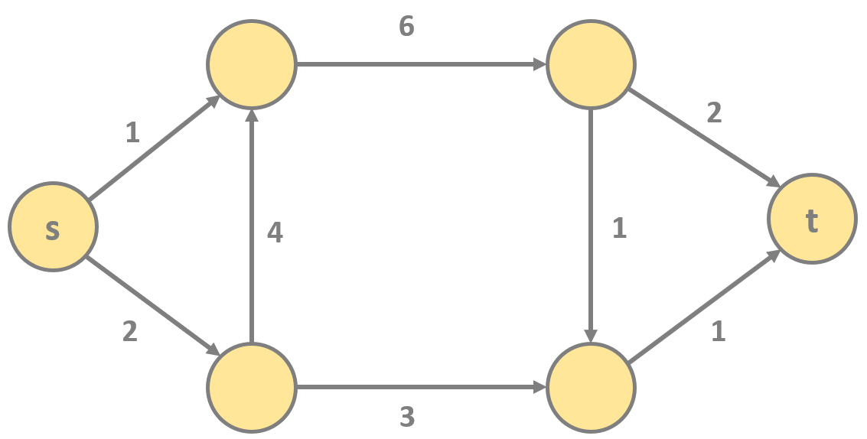
Maximum Flow Problem
we have a G(V,E) graph with V vertices and E directed edges
(in a flow network we have s source and t target or sink)
THE MAXIMUM FLOW PROBLEM IS TO FIND A FEASIBLE
FLOW FROM s TO t THAT IS MAXIMUM !!!
For example: flow of water in pipes or flow of cars
in the traffic where edges are the streets and roads
the flow is coming
from the s source
POSITIVE DIVERGENCE
the flow is heading
for the t sink
NEGATIVE DIVERGENCE

Slide 222
Maximum Flow Problem
we assign a c(u,v) capacity to every edge which is the maximum flow to that given edge (for example pipe or road)
we assign a f(u,v) flow value to every edge which is the actual flow. For example: 10 gallon of water/seconds that’s a flow
the flow is coming
from the s source
POSITIVE DIVERGENCE
the flow is heading
for the t sink
NEGATIVE DIVERGENCE

Slide 223
Maximum Flow Problem
FLOW / CAPACITY
1
0/9
2
0/10
0/15
0/10
0/4
0/15
s
0/5
3
0/8
4
0/10
t
0/4
0/6
0/15
0/15
0/10
5
6
0/16

Slide 224
Maximum Flow Problem
FLOW / CAPACITY
1
0/9
2
0/10
0/15
0/10
0/4
0/15
s
0/5
3
0/8
4
0/10
t
0/4
0/6
0/15
0/15
0/10
5
6
0/16

Slide 225
Maximum Flow Problem
FLOW / CAPACITY
1
0/9
2
0/10
0/15
0/10
0/4
0/15
s
0/5
3
0/8
4
0/10
t
0/4
0/6
0/15
0/15
0/10
5
6
0/16

Slide 226
Maximum Flow Problem
FLOW / CAPACITY
1
0/9
2
0/10
0/15
0/10
0/4
0/15
s
0/5
3
0/8
4
0/10
t
0/4
0/6
0/15
0/15
0/10
5
6
0/16
What is the aim? Given a flow network G(V,E) the aim is to find the flow
with maximum value from s source to t sink !!!

Slide 227
Max Flow Properties (Maximum Flow Problem)

Slide 228
Maximum Flow Problem
– CAPACITY CONSTRAINT –
for all u, v vertexes in the G(V,E) network graph, f(u,v) ≤ c(u,v)
so the f(u,v) flow can not be greater than the c(u,v) capacity

Slide 229
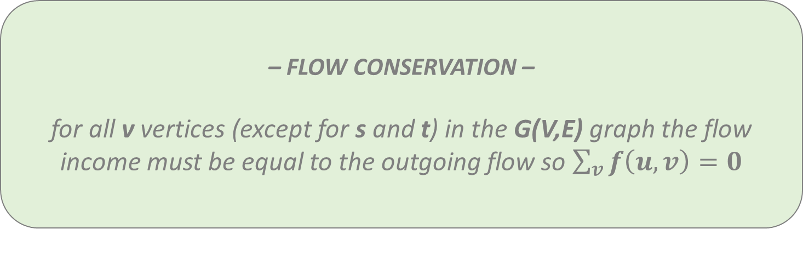
Maximum Flow Problem
– FLOW CONSERVATION –
for all v vertices (except for s and t) in the G(V,E) graph the flow income must be equal to the outgoing flow so $\sum_{v}{f\left(u,v\right)=0}$

Slide 230
Maximum Flow Problem
– SKEW SYMMETRY –
it is important when we want to prove the lemmas and theorems
so for all u, v in the G(V,E) network graph f(u,v) = - f(v,u)

Slide 231
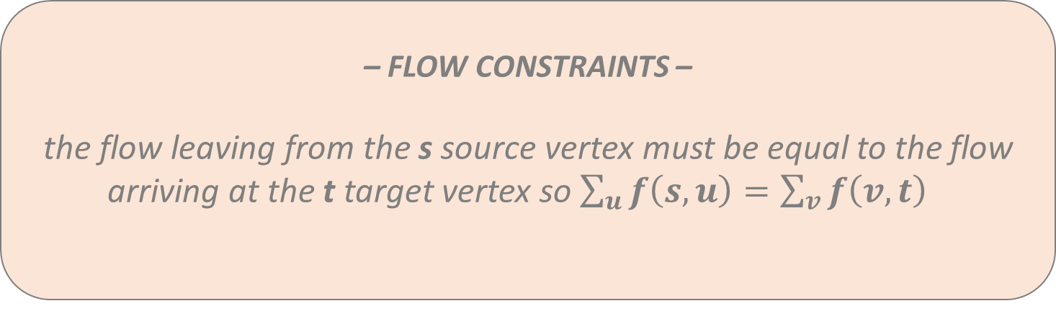
Maximum Flow Problem
– FLOW CONSTRAINTS –
the flow leaving from the s source vertex must be equal to the flow arriving at the t target vertex so $\sum_{u}{f\left(s,u\right)=\sum_{v}{f\left(v,t\right)} }$

Slide 232
Maximum Flow Problem
the incoming flow to vertex A is the same
as the sum of outgoing flows
INCOMING FLOW = OUTGOING FLOW
A
1/9
3/10
1/15
1/4

Slide 233
Maximum Flow Problem
the incoming flow to vertex A is the same
as the sum of outgoing flows
INCOMING FLOW = OUTGOING FLOW
A
1/9
3/10
1/15
1/4

Slide 234
Maximum Flow Problem
the incoming flow to vertex A is the same
as the sum of outgoing flows
INCOMING FLOW = OUTGOING FLOW
A
1/9
3/10
1/15
1/4

Slide 235
Maximum Flow Problem
This G(V,E) graph is a valid flow network
satisfies the capacity constraint
satisfies the flow conservation constraint
A
6/7
C
6/10
4/4
s
2/3
t
1/2
1/4
3/5
1/6
B
D
2/2

Slide 236
Maximum Flow Problem
This G(V,E) graph is a valid flow network
satisfies the capacity constraint
satisfies the flow conservation constraint
A
6/7
C
6/10
4/4
s
2/3
t
1/2
1/4
3/5
1/6
B
D
2/2

Slide 237
Maximum Flow Problem
This G(V,E) graph is a valid flow network
satisfies the capacity constraint
satisfies the flow conservation constraint
A
6/7
C
6/10
4/4
s
2/3
t
1/2
1/4
3/5
1/6
B
D
2/2

Slide 238
Maximum Flow Problem
The flow of the network is the flow from
the s source (or the flow to the t sink)
AND OF COURSE THE AIM OF THE MAX FLOW
PROBLEM IS TO MAXIMIZE THIS VALUE !!!
A
6/7
C
6/10
4/4
s
2/3
t
1/2
1/4
3/5
1/6
B
D
2/2

Slide 239
Cuts (Maximum Flow Problem)

Slide 240
Cuts
A cut (S,T) of a flow network G(V,E) is a partition of vertexes
such that every vertex will belong to either S of T

Slide 241
Cuts
A
6/7
C
6/10
4/4
s
1/2
t
2/3
1/4
3/5
1/6
B
D
2/2

Slide 242
Cuts
T
S
A
6/7
C
6/10
4/4
s
1/2
t
2/3
1/4
3/5
1/6
B
D
2/2

Slide 243
Cuts
S
T
A
6/7
C
6/10
4/4
s
1/2
t
2/3
1/4
3/5
1/6
B
D
2/2

Slide 244
Cuts
S
T
A
6/7
C
6/10
4/4
s
1/2
t
2/3
1/4
3/5
1/6
B
D
2/2

Slide 245
Cuts
A cut (S,T) of a flow network G(V,E) is a partition of vertexes
such that every vertex will belong to either S of T
HOW TO CALCULATE THE FLOW OF A CUT?
The flow accross the cut can be calculated by adding up all flows going
from one set of vertexes to the other (from S to T)

Slide 246
Cuts
A
6/7
C
6/10
4/4
s
1/2
t
2/3
1/4
3/5
1/6
B
D
2/2

Slide 247
Cuts
A
6/7
C
6/10
4/4
s
1/2
t
2/3
1/4
3/5
1/6
B
D
2/2
What is the flow f this cut? Have to consider every outgoing edge (positive)
and every incoming edge to the set (negative)

Slide 248
Cuts
A
6/7
C
6/10
4/4
s
1/2
t
2/3
1/4
3/5
1/6
B
D
2/2
What is the flow f this cut? Have to consider every outgoing edge (positive)
and every incoming edge to the set (negative)

Slide 249
Cuts
A
6/7
C
6/10
4/4
s
1/2
t
2/3
1/4
3/5
1/6
B
D
2/2
What is the flow of this cut? Have to consider every outgoing edge (positive)
and every incoming edge to the set (negative)

Slide 250
Cuts
A
6/7
C
6/10
4/4
s
1/2
t
2/3
1/4
3/5
1/6
B
D
2/2
FLOW OF THE CUT = 9 – 2 = 7

Slide 251
Cuts
A
6/7
C
6/10
4/4
s
1/2
t
2/3
1/4
3/5
1/6
B
D
2/2
What is the capacity of this cut? Have to consider every outgoing capacity (positive)
and every incoming capacity to the set (negative)

Slide 252
Cuts
A
6/7
C
6/10
4/4
s
1/2
t
2/3
1/4
3/5
1/6
B
D
2/2
What is the capacity of this cut? Have to consider every outgoing capacity (positive)
and every incoming capacity to the set (negative)

Slide 253
Cuts
A
6/7
C
6/10
4/4
s
1/2
t
2/3
1/4
3/5
1/6
B
D
2/2
What is the capacity of this cut? Have to consider every outgoing capacity (positive)
and every incoming capacity to the set (negative)

Slide 254
Cuts
A
6/7
C
6/10
4/4
s
1/2
t
2/3
1/4
3/5
1/6
B
D
2/2
CAPACITY OF CUT = 12 – 3 = 9

Slide 255
Max Flow Min Cut Theorem
the value of any flow is bounded by the capacity of any cut
so the maximum flow and the minimum cut has something to do with each other (not independent)
MAX FLOW MIN CUT THEOREM: the value of the maximum flow passing from source s to sink t is equal to the value of the minimum cut (so the total weight of edges in the minimum cut)
another important fact: the minimum cut is the smallest total weight of the edges which if removed would disconnect he source from the sink

Slide 256
Residual Network (Maximum Flow Problem)

Slide 257
Residual Network
We can transform the original G(V,E) flow network into a so-called G’(V,E) residual network
that will be crucial during the Ford-Fulkerson approach and other algorithms
c’(u,v) = c(u,v) – f(u,v) > 0
residual
capacity
original
capacity
flow in the original
G(V,E) graph

Slide 258
Residual Network
A
1/4
5/7
s
4/4
t
3/5
1/2
B
flow and capacity values in the
original G(V,E) graph

Slide 259
Residual Network
A
A
1/4
5/7
s
4/4
t
s
t
3/5
1/2
B
B
flow and capacity values in the
original G(V,E) graph
flow and capacity values in the
residual G’(V,E) graph

Slide 260
Residual Network
A
A
1/4
5/7
3
s
4/4
t
s
t
3/5
1/2
B
B
flow and capacity values in the
original G(V,E) graph
flow and capacity values in the
residual G’(V,E) graph

Slide 261
Residual Network
A
A
1/4
5/7
3
1
s
4/4
t
s
t
3/5
1/2
B
B
flow and capacity values in the
original G(V,E) graph
flow and capacity values in the
residual G’(V,E) graph

Slide 262
Residual Network
A
A
1/4
5/7
3
1
s
4/4
t
s
t
3/5
1/2
2
B
B
flow and capacity values in the
original G(V,E) graph
flow and capacity values in the
residual G’(V,E) graph

Slide 263
Residual Network
A
A
1/4
5/7
3
1
s
4/4
t
s
t
3
3/5
1/2
2
B
B
flow and capacity values in the
original G(V,E) graph
flow and capacity values in the
residual G’(V,E) graph

Slide 264
Residual Network
A
A
1/4
5/7
3
1
s
4/4
t
s
4
t
3
3/5
1/2
2
B
B
flow and capacity values in the
original G(V,E) graph
flow and capacity values in the
residual G’(V,E) graph

Slide 265
Residual Network
A
A
5/7
3
2
1/4
1
s
4/4
t
s
4
t
3
3/5
1/2
2
B
B
flow and capacity values in the
original G(V,E) graph
flow and capacity values in the
residual G’(V,E) graph

Slide 266
Residual Network
A
A
5/7
3
2
1/4
1
5
s
4/4
t
s
4
t
3
3/5
1/2
2
B
B
flow and capacity values in the
original G(V,E) graph
flow and capacity values in the
residual G’(V,E) graph

Slide 267
Residual Network
A
A
5/7
3
2
1/4
1
5
s
4/4
t
s
4
t
3
2
3/5
1/2
2
B
B
flow and capacity values in the
original G(V,E) graph
flow and capacity values in the
residual G’(V,E) graph

Slide 268
Residual Network
A
A
5/7
3
2
1/4
1
5
s
4/4
t
s
4
t
3
2
3/5
1/2
2
1
B
B
flow and capacity values in the
original G(V,E) graph
flow and capacity values in the
residual G’(V,E) graph

Slide 269
Algorithms for the Problem (Maximum Flow Problem)

Slide 270
Ford-Fulkerson Algorithm
AUGMENTING PATH
An augmenting path only exists in the residual G’(V,E) network which is
a simple path from s to t in the G’(V,E) residual network
→ if there is an augmenting path in G’(V,E) we know
for certain that the flow in G(V,E) is not maximal
→ if there is no more augmenting paths in G’(V,E) it means
we can terminate the algorithm with the max flow

Slide 271
Ford-Fulkerson Algorithm
– INITIALIZATION –
initialize the flow in the G(V,E) original flow network to be zero at the beginning so f(u,v) ← 0 for all u,v in V

Slide 272
Ford-Fulkerson Algorithm
– INITIALIZATION –
initialize the flow in the G(V,E) original flow network to be zero at the beginning so f(u,v) ← 0 for all u,v in V
– ALGORITHM –
while there is a path from s to t in the G’(V,E) residual network:
find that given augmenting path p and do augment flow along path p in the G(V,E) original flow network

Slide 273
Edmonds-Karp Algorithm
we know from Ford-Fulkerson algorithm that we have to find the augmenting paths in the G’(V,E) residual network
there are several graph traversal algorithms to traverse a graph
Edmons-Karp algorithm uses BFS (breadth-first seach) to find these augmenting paths
running time of Edmonds-Karp algorithm is O(VE²)
running time of Dinic algorithm is O(V²E)

Slide 274
Illustration (Maximum Flow Problem)

Slide 275
Maximum Flow Problem
A
A
0/7
4
7
0/4
s
0/4
t
s
4
t
0/5
0/1
5
1
B
B
flow and capacity values in the
original G(V,E) graph
flow values in the
residual G’(V,E) graph

Slide 276
Maximum Flow Problem
A
A
0/7
4
7
0/4
s
0/4
t
s
4
t
0/5
0/1
5
1
B
B
flow and capacity values in the
original G(V,E) graph
flow values in the
residual G’(V,E) graph

Slide 277
Maximum Flow Problem
A
A
0/7
4
7
0/4
s
0/4
t
s
4
t
0/5
0/1
5
1
B
B
MIN(5,1)
flow and capacity values in the
original G(V,E) graph
flow values in the
residual G’(V,E) graph

Slide 278
Maximum Flow Problem
A
0/4
0/7
s
0/4
t
1/5
1/1
B
flow and capacity values in the
original G(V,E) graph

Slide 279
Maximum Flow Problem
A
A
0/7
4
7
0/4
s
0/4
t
s
4
t
1
1/5
1/1
4
1
B
B
flow and capacity values in the
original G(V,E) graph
flow values in the
residual G’(V,E) graph

Slide 280
Maximum Flow Problem
A
A
0/7
4
7
0/4
s
0/4
t
s
4
t
1
1/5
1/1
4
1
B
B
flow and capacity values in the
original G(V,E) graph
flow values in the
residual G’(V,E) graph

Slide 281
Maximum Flow Problem
A
A
MIN(4,7)
0/7
4
7
0/4
s
0/4
t
s
4
t
1
1/5
1/1
4
1
B
B
flow and capacity values in the
original G(V,E) graph
flow values in the
residual G’(V,E) graph

Slide 282
Maximum Flow Problem
A
4/4
4/7
s
0/4
t
1/5
1/1
B
flow and capacity values in the
original G(V,E) graph

Slide 283
Maximum Flow Problem
A
A
4/7
4
3
4/4
4
s
0/4
t
s
4
t
1
1/5
1/1
4
1
B
B
flow and capacity values in the
original G(V,E) graph
flow values in the
residual G’(V,E) graph

Slide 284
Maximum Flow Problem
A
A
4/7
4
3
4/4
4
s
0/4
t
s
4
t
1
1/5
1/1
4
1
B
B
flow and capacity values in the
original G(V,E) graph
flow values in the
residual G’(V,E) graph

Slide 285
Maximum Flow Problem
A
A
MIN(4,4,3)
4/7
4
3
4/4
4
s
0/4
t
s
4
t
1
1/5
1/1
4
1
B
B
flow and capacity values in the
original G(V,E) graph
flow values in the
residual G’(V,E) graph

Slide 286
Maximum Flow Problem
A
4/4
7/7
s
3/4
t
4/5
1/1
B
flow and capacity values in the
original G(V,E) graph

Slide 287
Maximum Flow Problem
A
A
4/4
7/7
4
7
s
3/4
t
s
3
1
t
4
4/5
1/1
1
1
B
B
flow and capacity values in the
original G(V,E) graph
flow values in the
residual G’(V,E) graph

Slide 288
Maximum Flow Problem
A
A
4/4
7/7
4
7
s
3/4
t
s
3
1
t
4
4/5
1/1
1
1
B
B
flow and capacity values in the
original G(V,E) graph
WE ARE NOT ABLE TO GET FROM s TO t
WHICH MEANS THE ALGORITHM TERMINATES !!!

Slide 289
Maximum Flow Problem
A
4/4
7/7
s
3/4
t
4/5
1/1
B
if we want to find the minimum cut then we have to start with s source
and visit the neighbor nodes until the edges are full

Slide 290
Maximum Flow Problem
A
4/4
7/7
s
3/4
t
4/5
1/1
B
if we want to find the minimum cut then we have to start with s source
and visit the neighbor nodes until the edges are full

Slide 291
Maximum Flow Problem
A
4/4
7/7
s
3/4
t
4/5
1/1
B
if we want to find the minimum cut then we have to start with s source
and visit the neighbor nodes until the edges are full

Slide 292
Maximum Flow Problem
A
4/4
7/7
s
3/4
t
4/5
1/1
B
if we want to find the minimum cut then we have to start with s source
and visit the neighbor nodes until the edges are full

Slide 293
Maximum Flow Problem
A
4/4
7/7
s
3/4
t
4/5
1/1
B
if we want to find the minimum cut then we have to start with s source
and visit the neighbor nodes until the edges are full

Slide 294
Maximum Flow Problem
A
4/4
7/7
s
3/4
t
4/5
1/1
B
if we want to find the minimum cut then we have to start with s source
and visit the neighbor nodes until the edges are full

Slide 295
Maximum Flow Problem
A
4/4
7/7
s
3/4
t
4/5
1/1
B
if we want to find the minimum cut then we have to start with s source
and visit the neighbor nodes until the edges are full

Slide 296
Maximum Flow Problem
A
4/4
7/7
s
3/4
t
4/5
1/1
B

Slide 297
Maximum Flow Problem
S
A
T
4/4
7/7
s
3/4
t
4/5
1/1
B
WE CAN COME TO THE CONCLUSION THAT THE MAXIMUM FLOW IS EQUAL TO THE MINIMUM CUT !!!

Slide 298
Applications (Maximum Flow Problem)

Slide 299
Maximum Flow Problem
TELECOMMUNICATION AND NETWORKING
communication networks have a set of requests to transmit messages between servers that are connected by channels
they are capable of transferring information at varying rates
what is the maximum rate at which information can be transferred between two specified servers in the network?
if there are costs associated with the channels, what is the cheapest way to send the information at a given rate that is less than the maximum?

Slide 300
Maximum Flow Problem
BIPARTITE MACHING
suppose that we have N students each needing jobs
there are N companies each needing to hire a student
these two lists (one sorted by students and the other sorted by companies) give a list of job offers which indicate mutual interest in matching students and jobs
is there some way to match students to jobs so that every job is filled and every student gets a job?
if not, what is the maximum number of jobs that can be filled?

Slide 301
Maximum Flow Problem
EVACUATION
a city government needs to formulate a plan for evacuating people from the city in an emergency
what is the minimum amount of time that it would take to evacuate the city if we suppose that we can control traffic flow so as to realize the minimum?
traffic planners also might formulate questions like this when deciding which new roads, bridges or tunnels might alleviate in rush-hours

Slide 302
Maximum Flow Problem
DURING II. WORLD WAR
given roads connecting an army's supply depot
make bombing plan that would separate troops from supplies
the enemy’s goal is to minimize the cost of bombing (perhaps assuming that the cost of cutting an edge is proportional to its width)
the army's goal is to design its road network to maximize the enemy's minimum cost

